Slide 1



mobile
View in Power BI
Last data refresh:
2/5/2024 1:04:13 PM UTC
Downloaded at:
2/5/2024 1:05:18 PM UTC

Slide 2
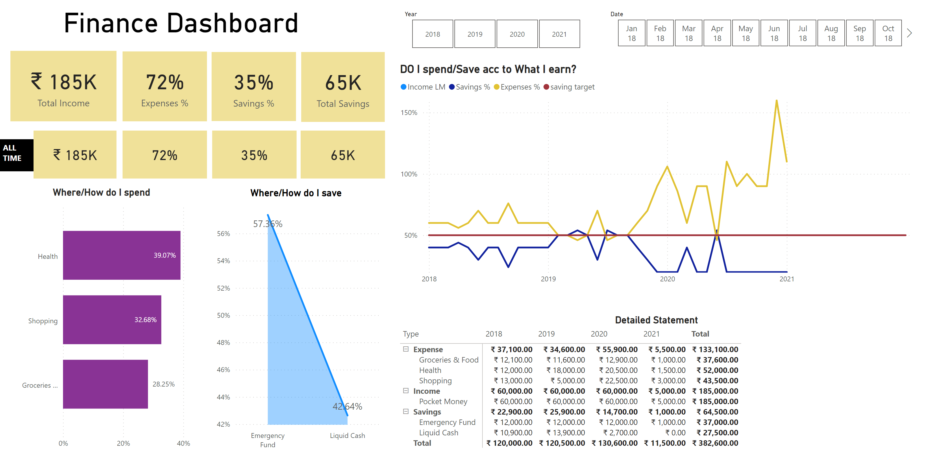
Page 1
Notes:
card
No alt text provided
card
No alt text provided
card
No alt text provided
card
No alt text provided
slicer
No alt text provided
slicer
No alt text provided
card
No alt text provided
card
No alt text provided
card
No alt text provided
card
No alt text provided
textbox
No alt text provided
card
No alt text provided
Where/How do I spend
No alt text provided
Where/How do I save
No alt text provided
DO I spend/Save acc to What I earn?
No alt text provided
Detailed Statement
No alt text provided

Slide 3
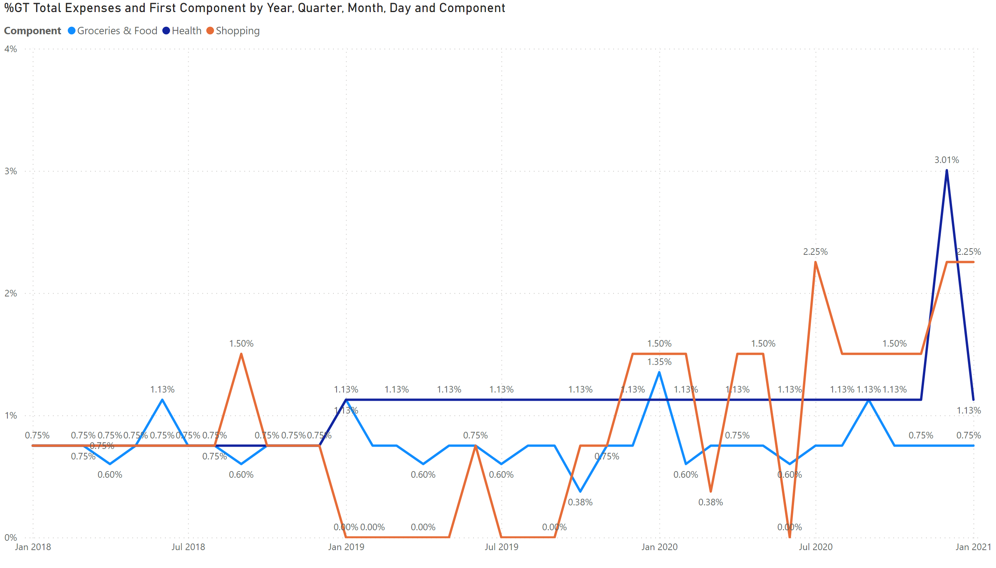
TT1
Notes:
lineChart
No alt text provided

Slide 4
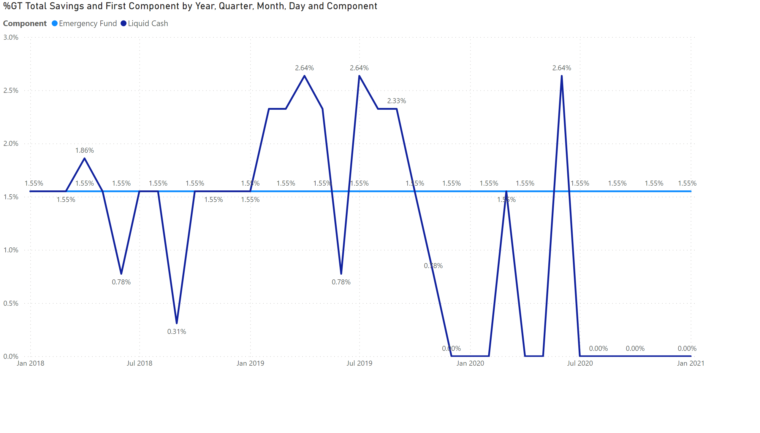
TT2
Notes:
lineChart
No alt text provided

